Slide 1

The Talent You Need
is Already Inside Your Company
Damon Edwards
@damonedwards

Slide 2
TALENT*
*The people who have the skills necessary to make your business successful

Slide 3
Please note…
This is not a HR talk
This is not a skills development talk
This is a talk about technical management
Notes:
About creating the conditions for your people to flourish

Slide 4
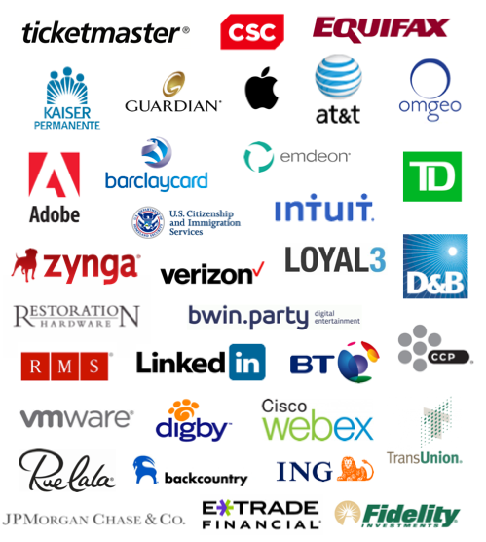


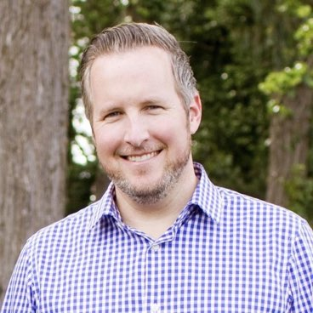

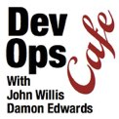

I’ve gotten to see a lot…
Tools
Ops Improvement
DevOps Consulting
Damon
Edwards
Community

Slide 5

“we can’t find the talent we need to be successful in our transformation”
Executives Everywhere

Slide 6

The “Buy” Mindset
If only our recruiters could hire the best like the unicorns do.

Slide 7
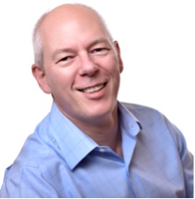
The “Buy” Mindset Meets Reality
If only our recruiters could hire the best like the unicorns do.
Adrian, where did you find all of your talent??
Adrian Cockcroft
(Netflix at the time)
C-Level Execs
Fortune 100’s

Slide 8
The “Buy” Mindset Meets Reality
“I hired them from you!
If only our recruiters could hire the best like the unicorns do.
Adrian, where did you find all of your talent??
Adrian Cockcroft
(Netflix at the time)
C-Level Execs
Fortune 100’s
Notes:
Can’t beat them by out spending… they are dedicated to paying top of market… “Buy” mindset is a losing proposition when people who are already considered more desirable places to work are committed to not being outspent.

Slide 9
The “Grow” Mindset
1
Grow the talent
Retain the talent
Happy talent attracts more talent
2
3
Notes:
Let’s compare that with what we see the people doing who AREN’T complaining they can’t find the talent they need.

Slide 10
The “Grow” Mindset
1
Grow the talent
Retain the talent
Happy talent attracts more talent
?
2
3

Slide 11

Remember this isn’t a HR talk…
I don’t know how to fix and develop the individual

Slide 12
… my focus is on the systemic conditions
Excessive Meetings
Conflicts
Bottlenecks
Unclear Priorities
Rework
Too much WIP
Lack of Feedback
Waiting
Excessive “Approvals”
Repetitive Manual Work
Notes:
I know how to focus on removing the friction so the people doing the work, as a whole, can flourish.

Slide 13
You need a system.
“Average leaders have quotes. Good leaders have a plan. Exceptional leaders have a system.”
-Urban Meyer
Notes:
Whenever people ask me about how to transform an organization. I’m always reminded about this gem from Urban Meyer (one of the winningest American football coaches ever). We see this with DevOps transformations… Average orgs talk about getting better, Good ones execute on improvement plans, exceptional orgs are systematically focused on getting better… their system makes them good at getting better.
TRAN-OUT: What’s the goal of our system? We already know the goals of the system from a business perspective… Lead times, quality, cost… but what about the goals from a people perspective? How do we know this system is creating the conditions in which our people are flourishing… the rich conditions in which we can grow and retain talent.

Slide 14
How do we know we are creating better conditions?
People Burnout*
Work Overload
Lack of Control
Insufficient Rewards
Breakdown of Community
Absence of Fairness
Value Conflicts
*Christina Maslach, UC Berkeley
Organizational risk factors for burnout
Notes:
I think we can start by looking at what we don’t want. Lets look at the conditions in which people do not flourish. The toxic environments that all IT workers want to avoid.
Maslack 6 org risk factors that predict burnout
Work Overload - Job demands exceed human limits, too much simultaneous work in progress, too much rework
Lack of control - Inability to influence decisions that affect your job, bad things you can’t control constantly dumped on you in unpredictable ways
Insufficient rewards - insufficient financial, institutional, or societal rewards
Breakdown of community - unsupportive workplace environment, us vs them, overt or covert aggression or hostility between teams
Absence of fairness — lack of fairness in decision-making process, you get blamed for things you can’t control
Value conflicts - mismatch in organizational values and the individual’s values, doesn’t have to be major opposition to what the company does… maybe you just don’t see any connection between how you are treated or the outcomes of your work and the outcomes of the company

Slide 15
How do we know we are creating better conditions?
People Burnout*
People Thrive*
Work Overload
Lack of Control
Insufficient Rewards
Breakdown of Community
Absence of Fairness
Value Conflicts
Leveled Work
Empowered
Sufficient Rewards
Supportive Community
Fairness and Transparency
Aligned Values
*Christina Maslach, UC Berkeley
Organizational risk factors for burnout
*John Willis and I
Notes:
This isn’t part of Dr Maslack’s research.. but John Willis (my podcasting partner) and I noticed that if you take the inverse of each of these, you actually get a recipe of a positive and healthy.. it reads the the high performing organizations we see.
Leveled work - workload on the individual is at a steady, manageable pace with minimal work in progress and sufficient slack
Empowered - ability and authority to influence and improve the work you do and the conditions of the team around you
Sufficient rewards - feeling content with the rewards you receive. Extrinsic (like money) is important. But Intrinsic, like pride, accomplishment, and feeling appreciated, are even bigger factors.
Supportive community - a supportive workplace environment where you are made stronger, better, and more secure by your colleagues across the company
Fairness and transparency - decisions are made by well understood criteria and the decision making process is fair and transparent. Blame is placed on the system and not on the individual.
Aligned values - you feel your values are aligned with others in the company

Slide 16
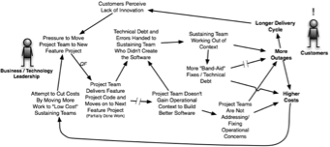
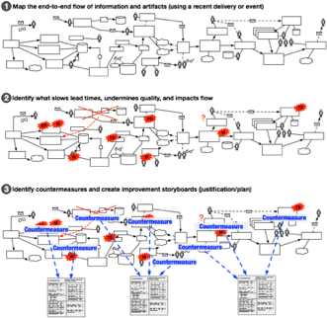
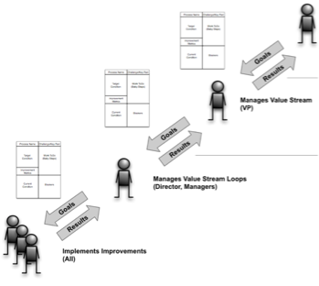
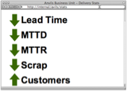
About that system… Let’s lean on Lean
Systems Thinking
Value Stream Mapping
Lean Waste Analysis
Service Delivery Metrics
A3/ Improvement Kata

Slide 17
About that system… Let’s lean on Lean
Systems Thinking
Value Stream Mapping
Lean Waste Analysis
Service Delivery Metrics
A3/ Improvement Kata
Google: DOES15 DevOps Kaizen

Slide 18
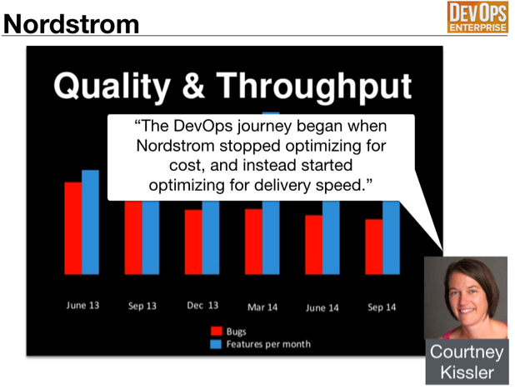
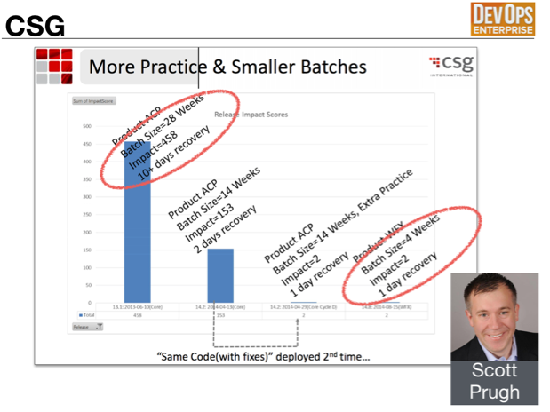
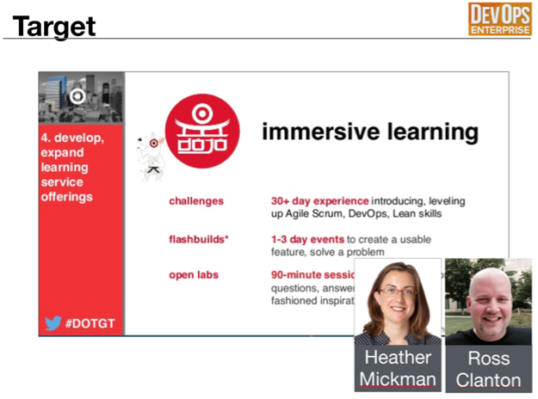
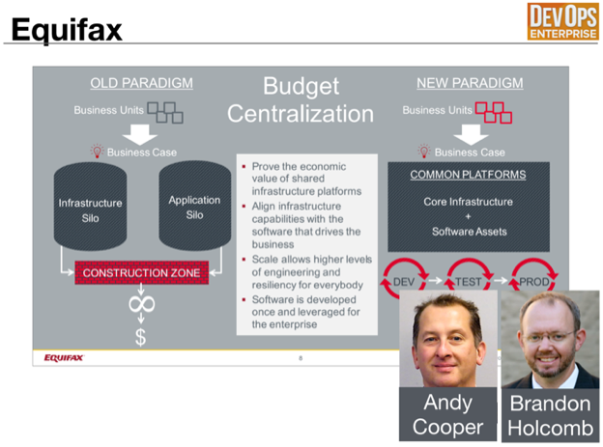

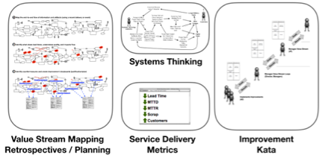
Design patterns that remove friction & help people thrive
Design Patterns
DevOps Kaizen
Improvement System

Slide 19
DevOps Enterprise is a great source of these patterns
“Focus on speed”
“Reduce batch sizes”

Slide 20
DevOps Enterprise is a great source of these patterns
“Dojo model to uplift teams”
“Platforms funded as products”

Slide 21
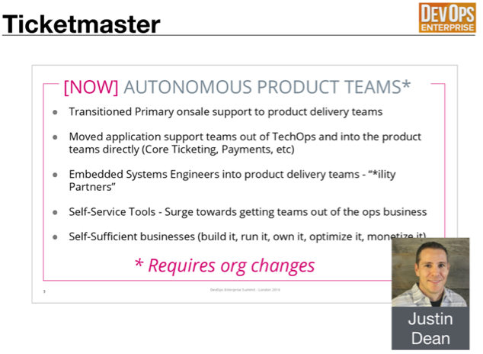
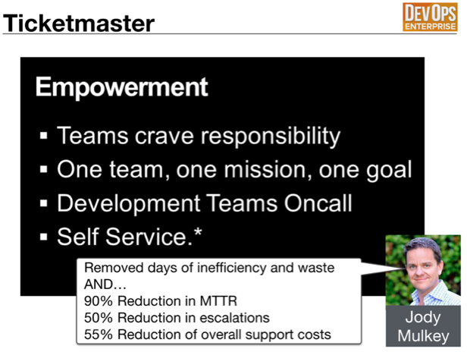
DevOps Enterprise is a great source of these patterns
“Autonomous product teams”
“Empowering teams”
Prerequisite: Simplify Operations

Slide 22

Common perception of Enterprise DevOps Transformations
Planning
Dev/Test
Release
Operate

Slide 23
Common perception of Enterprise DevOps Transformations
Planning
Dev/Test
Release
Operate
Cross-Functional Product Teams
Cross-Functional Product Teams
Cross-Functional Product Teams

Slide 24
Current Reality of Most Enterprise DevOps Transformations
?
Planning
Dev/Test
Release
Operate
Cross-Functional Product Teams
Cross-Functional Product Teams
Cross-Functional Product Teams

Slide 25



Complexity of Enterprise Operations
I just need an environment!
Something isn’t working!
Ticket
System
SecOps
SysEng
Ticket
System
Ticket
System
PM
SysAdmin
NetEng
CDN
DNS
DBA

Slide 26
End-to-End DevOps Transformation
1. Simplify
Planning
Dev/Test
Release
Operate
Cross-Functional Product Teams
2. Integrate
Cross-Functional Product Teams
3.Enable
Cross-Functional Product Teams
Standard Platforms
Ops
APIs

Slide 27
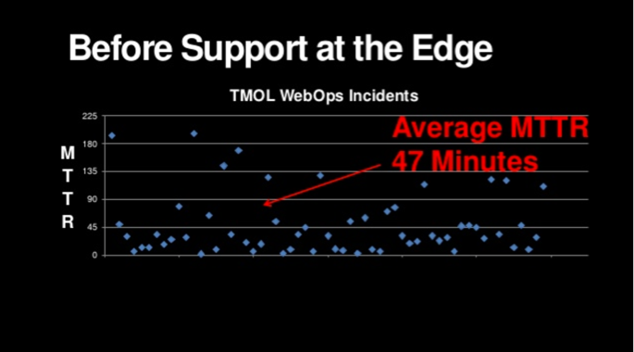
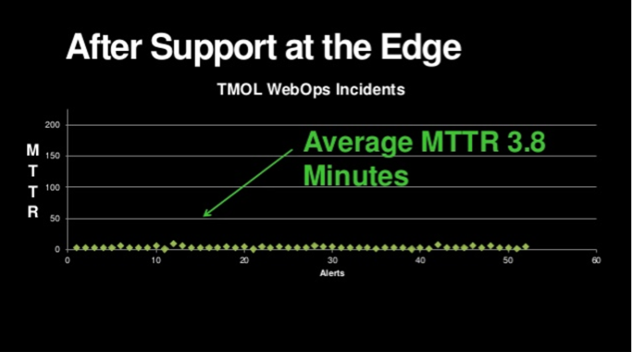
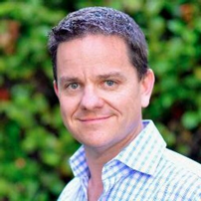
Example: Ticketmaster’s “Support at the Edge” Pattern
Jody
Mulkey

Slide 28
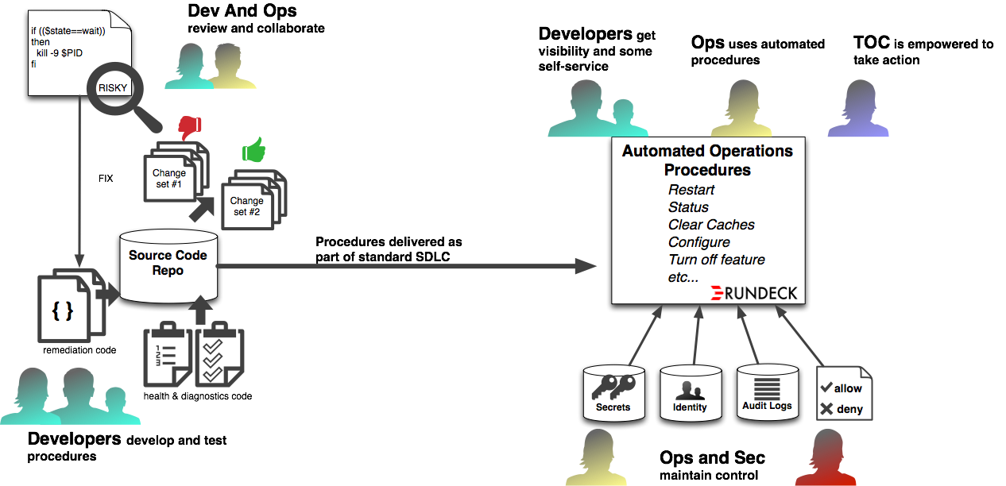
My interpretation of how they did it
Dev/Test
Prod

Slide 29
Better for the business and better for employees
AND…
90% Reduction in MTTR
50% Reduction in escalations
55% Reduction of overall support costs

Slide 30
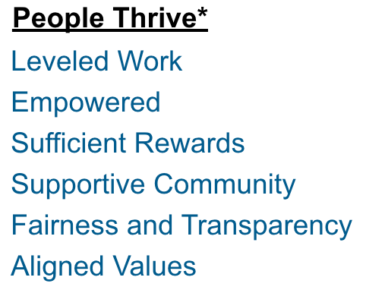
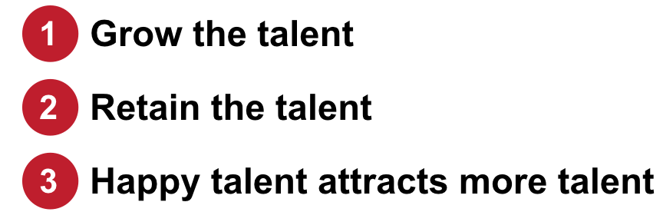
Recap
Mindset: “Grow”
Goal: Inverse of Maslach risk factors

Slide 31
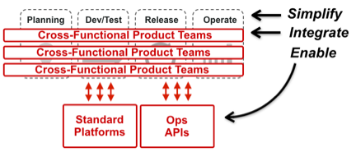
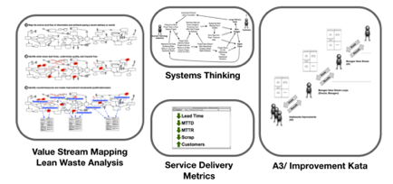
Recap
Put an improvement system in place
Focus on removing friction
Go all the way with Ops
DevOps Kaizen
And don’t forget all of the HR stuff I didn’t talk about!

Slide 32
Let’s talk! Especially about Simplifying Ops!
damon@simplifyops.com
@damonedwards
Get the slides here

